Slide 1
Corporate Presentation
TOKENIZED SERVICES FACTORY
April 2018

Slide 2
Company Profile
Cub3Tech LTD is a private company founded in May 2015 registered in UK (London) with its Operations and Technical Support (Spanish and English) in the USA. It reported revenues of 164,719£ for its first year of operation (2016)
The company has been founded by Payment and NFC industry experts having worked in pioneering 90s and 2000s companies like IBM, Gemalto, Inside Secure … as well as in Transactions processors (ATOS, locals)
Cub3Tech offers a best-of-breed vision for Cloud-based mobile payment with an implementation based on “fully in-house developed” components : EMV mobile applets, secured protocols for all transactions and a TSP vault (Token Service Provider) with robust I.T. architecture and 100% modular and customizable
Cub3Tech is offering a ready-to-go Cloud-based payment solution. Cub3Tech components are 100% compliant with EMV Payment Tokenization Specification V1.0 released in March 2014 by EMVCo, and following updates

Slide 3
megatrends in Mobility
It all started in 2014
Host Card Emulation (HCE) was added to the new Android Operating System (KitKat 4.4) released by Google
International Payment Schemes (VISA, Mastercard …) published their support for HCE and are endorsing tokenization mechanisms for various usecases
EMVCo organization defined the role of Token Service Provider (TSP)
In addition
Apple launched iPhone 6 and beyond (as well new iWatch), leveraging NFC technology
Today, an impressive list of more than 300 handsets supporting NFC
Contactless POS infrastructure is growing fast everywhere
Samsung-Pay has different set-up per country, always including HCE

Slide 4
while, Digital Commerce is under fire
Acceleration of fraudulent activities
Current countermeasures have failed partially
Strong SSL authentication,
PCI conformity (not storing sensitive data, PAN, CVV2, expiration date),
Monitoring and scoring,
Layering security, encryption End-to-End, 3D-Secure, etc.
Standardized
EMVCo tokenization was designed to use current ISO/IEC 8583 message formats that support interoperability with the existing payments infrastructure. It is intended to fight against fraud in current CNP channels (such as online transactions)
Mobile Present
Transactions!

Slide 5
Timing is perfect for Digital Transformation
Not a technology choice any more !
Mobile at the heart of digital interactions
Demanding & self-driven consumers
Speed of OTT’s and FinTech’s
Digital transformation of businesses
Payment regulations

Slide 6
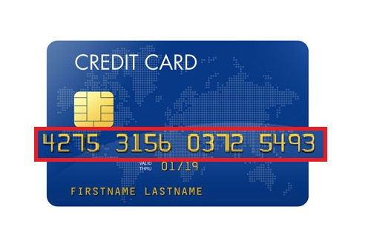
Digital cards on all devices
Consumer Devices, Internet of Things
CARD MANAGEMENT SYSTEM
TOKEN MANAGEMENT SYSTEM

Slide 7
CUB3 Services Platform
Facilitate on-boarding & provide tokenization to Requestors
CUB3 Services Platform
Lifecycle management
Tokenization management
Transaction management
Mobile platform
e-Commerce
Token Requestors
for services - aggregators wallets
Server-based
Mobile App’
Transaction
Processors
Domestic
Networks
Innovative
FinTech’s
mPOS
Acquirers

Slide 8
Digital Card CUB3 – Instant Issuance
Standard Tokenization EMVCo, messaging between parties identical
No changes for acquirer, easy integration (APIs)
Benefits to Issuers
Support multiple payment brands and domestic/private schemes
Security & functional certification
Mobile proximity payment, leveraging growing contactless infrastructure
Benefits to users
Digital card immediately with physical card
Facilitate usage of NFC & e-Commerce transactions
Increased UI familiarity (Intuitive, consistent and fluid)
High security transactions
Digitalized card
Merchant

Slide 9
Product portfolio & Software components
Platform (server side)
CUB3 Services Platform, including the following 6 modules:
Tokenization Management (LUK/SUK generation, tokens life cycle management, vault)
Token Requestor Gateway for international Payment Schemes (Visa, Mastercard, Discover …)
Life Account management (enrolment, ID&V and Issuers API)
Transaction management (PIN and cryptograms validation, de-tokenization, issuers API authorization)
Mobile platform (wallet authentication, communication security)
E-Commerce module
Mobile (client side)
Mobile SDK, or alternatively white-label App’ (APDUs and crypto generation)
mPOS, with two options: NFC or QR codes
Browser extension & button
CPP: CUB3 Plug-in Pay (extension to enable tokenized e-commerce)
CPB: CUB3 Payment Button

Slide 10
Business models
CUB3TECH is a versatile provider:
either of tokenized Services in a SaaS mode
either of tokenization SW components to be installed « on premises »
Modularity of the platform, standardized & interoperable API’s
Allow integrations into existing 3rd parties components or full CUB3 deployments
Facilitate mixed solutions (e.g. partially SaaS) and white-labelled solutions resale
Business models
Generally aligning with deployments (per transaction for SaaS, licenses on premises)
But all models are contemplated including « operated services » on premises

Slide 11
Tokenization … Urgency for Issuers
Risk management, multiplication of use-cases
Before …
Now …
Account
Card
Managed by the same entity
Losing control …
Gartner: Banks need to think in terms of secure credentials
management to accomodate all the payment scenarios

Slide 12
Benefits for Issuers
Higher profile
Own branded wallet (« Top of wallet »)
Manage its own wallet rules
The account/card-holder pays « with his/her financial institution »
Autonomy
For its digitalization strategy, timing
For its deployment & offer of use-cases
Evolution
Roadmap of services (e-Commerce, Loyalty, embedded payment flows)
Multi-partners and own payment solutions, as well as issuing tools (instant issuance)
Adapts, depending of its clients, its markets and its competition
« HCE Industrialization &
deployment fit into a broader
strategic choices issuers face to
control their data, business model
and payment infrastructure »

Slide 13
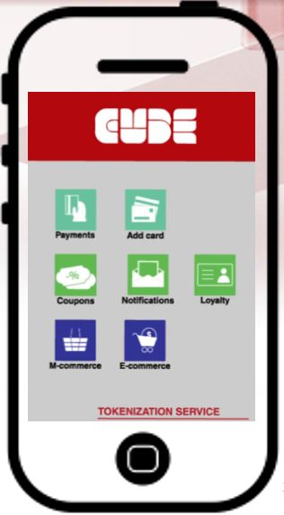
Takeways
CUB3 Services Platform
Connect once, deploy anywhere (unique Issuer API)
Issuer-controlled tokenization or support for 3rd-parties tokenization vaults
Innovative and future-proof technology, as:
Respecting the privacy and control of the customers/users for all use-cases
Leveraging the mobile phone as their main and favorite U.I.
Supports all major international card schemes staying agnostic: CUB3 platform manages tokens from CUB3, Visa, Mastercard …
CUB3 is your « Token Factory » partner !

Slide 14
References & Partners

Slide 15
mOBILE PRESENT TRANSACTIONS !
contact@cube-hce.com

